Slide 1

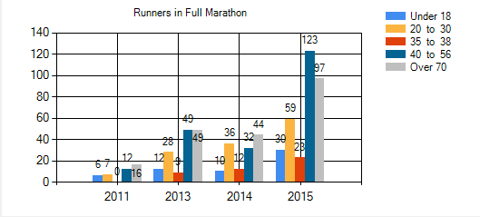
35. Runner Report
Marathon Skills 2015 – Add a new user
Back
MARATHON SKILLS 2015
Logout
Runner Report
Marathon Type:
Full Marathon
Criteria List
Select Year
Under 18
18 to 27
28 to 44
45 to 62
Over 62
Age Criteria:
Over
-
62
Add Criteria
Remove Criteria
Generate
Result
Graph Type :
Column
Export to Excel
18 days 8 hours and 17 minutes until the race starts!

Slide 2
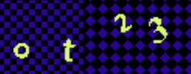
35. Runner Report
Marathon Skills 2015 – Add a new user
Back
MARATHON SKILLS 2015
Logout
Runner Report
Marathon Type:
Full Marathon
Criteria List
Select Year
Under 18
18 to 27
28 to 44
45 to 62
Over 62
Age Criteria:
Over
-
62
Add Criteria
Remove Criteria
Generate
Result
Graph Type :
Column
Cancel
Generate
Say
ot23
Submit
Export to Excel
18 days 8 hours and 17 minutes until the race starts!

